Slide 1


Intelligent Agent
File Segregation System Powered by Intelligent Agents
Challenges with digital data
File Classification - organisation and segregation
Automate using intelligent agents
Notes:
Hello and welcome, this is our team presentation about the practical development of intelligent agent for the purpose of file classification.
In the current world, computerised devices and digital data are integral to our everyday lives. This has led to significant challenges for businesses and individuals.
The first important challenge is organising and categorising vast quantities of files generated. This is to ensure efficient management and accessibility. Secondly, classifying suspicious files is crucial for identifying and mitigating security threats, preventing malware propagation and protecting both data and systems.
Not all suspicious files are necessarily malicious. But some files may trigger suspicion due to false positives or legitimate activities that may appear unusual. Proper classification helps differentiate between genuine threats and benign files, reducing the chances of false alarms and unnecessary disruptions.
This project aims to automate file classification using intelligent agents, by using the speed and efficiency of intelligent agents. The project intends to simplify the identification of ordinary and potentially dangerous file types, thereby enhancing file management and security.

Slide 2

Perceive
Reason
Extract knowledge
Inference
Derive conclusion
Autonomous decisions
Background
Architecture: Reactive
Intelligent Agents in AI
Architecture
Communication
Collaboration
Communication: protocols, languages and frameworks
Collaboration with users and other agents to achieve shared goals
Notes:
Now let’s look at the context of our project. An intelligent agent is basically a software program based system that has the ability to perceive its environment through sensors or input data, and use this to understand the environment, employ reasoning mechanisms to process and analyse the information they perceive, use algorithms, logic or machine learning techniques to extract knowledge, make inferences and derive conclusions based on available data. Based on the reasoning process they can make autonomous decisions or provide recommendations
In our current work, we have utilised intelligent agent to perceive the system environment that awaits for user to input files, used rule based system to define normal and suspicious files. Here we have used reactive agent architecture. The main reason we used it is the requirement of real-time response for the user file input and complex reasoning was not required.
Agents communicate by communication protocols, languages, and frameworks to exchange information and coordinate actions in multiagent systems.
Agents learn using knowledge base to acquire knowledge, learn from experience, and adapt their behavior based on changing circumstances.
Multiple agents work together on specific tasks and cooperate, negotiate, and collaborate to achieve shared goals or solve complex problems. Agents can communicate with user as well to exchange information

Slide 3
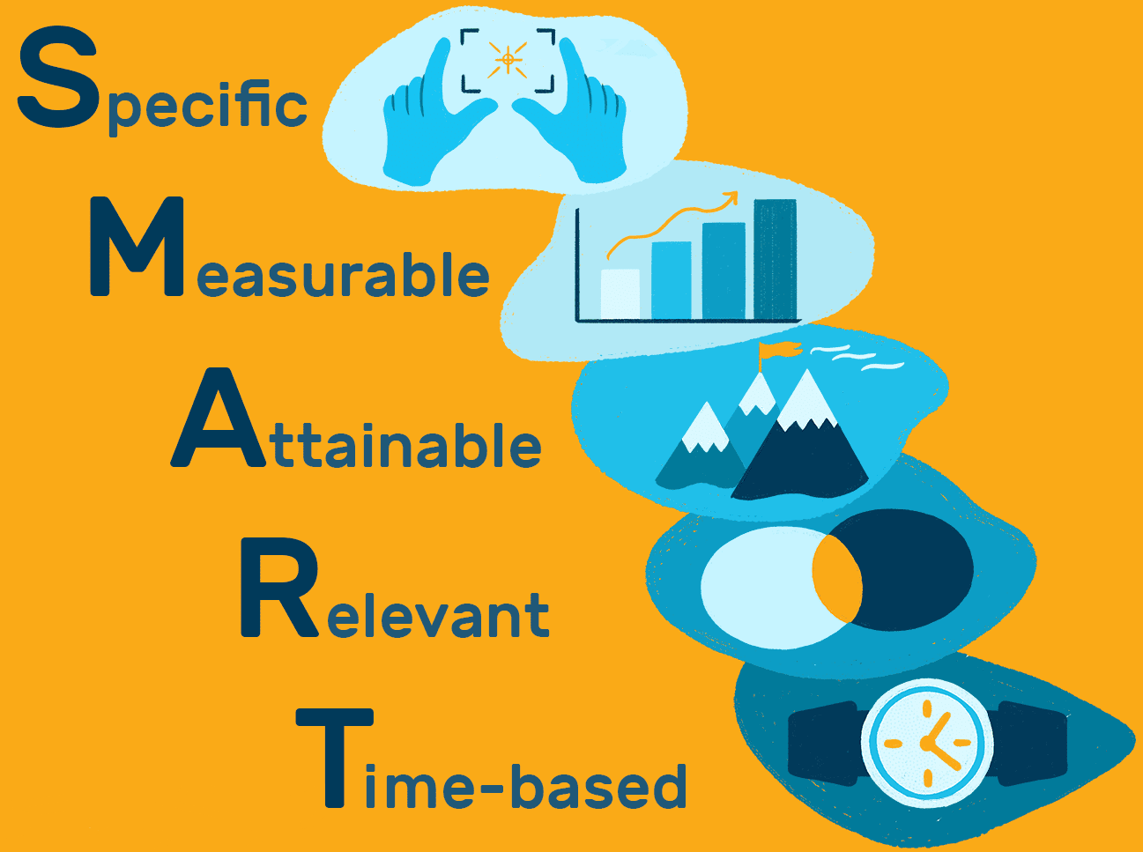
To develop intelligent agents - to analyse file name extensions for classification - > 10 different file types - accuracy rate > 95% - timeline 10 days.
Objectives
To create a user-friendly interface - users to review and validate the classification results - provide feedback on any misclassifications - timeframe 10 days.
To conduct testing and validation processes - dataset of 1,000 files representing a diverse range of file types - To achieve an accuracy rate of >90% - ensure classification process < 5 seconds per file - timeline 5 days
Notes:
We formulated SMART objectives, so that our project team can have clear, specific and measurable targets that are achievable and time-bound, they provide guidance and focus throughout the project's development, testing, and validation phases
Our main objectives were to develop intelligent agents capable of accurately analysing file name extensions for classification of at least 10 different file types with an accuracy rate of 95% or higher, within a timeline of 10 days.
Also to create a user-friendly interface that allows users to review and validate the classification results, to provide feedback on any misclassifications and to complete this process within a timeframe of 10 days.
And finally to conduct rigorous testing and validation processes on the intelligent agents, including a dataset of 1,000 files representing a diverse range of file types, to achieve an accuracy rate of 90% or higher and ensure that the classification process takes no more than 5 seconds per file, within a timeline of 5 days.

Slide 4
Reactive Agent
Methodology
Use of reactive agents for fast and efficient response
Multi Agent
Multi-agent system for file classification
Collaboration
Collaboration and interaction among agents
Notes:
In this presentation, we will delve into the advantages of utilizing a multi-agent system as a practical solution, while also providing detailed insights into our rationale for choosing the reactive type to develop all the agents involved in the project.
To attain a common objective, it is essential to establish coordination and interaction among numerous agents. As described by Wooldridge (2009), these agents collaborate by leveraging their distinct capabilities and knowledge, enabling them to effectively tackle complex tasks that would prove challenging for a single agent. In our project, we are harnessing the potential of multi-agent systems to enhance the efficiency of file classification. By leveraging the collective power of these agents, we can achieve accurate and efficient file classification, leveraging their collaborative abilities.
Now, let's turn our attention to a noteworthy study conducted by Peng et al. (2001) that compared single and multi-agent systems in the domain of file classification. This research meticulously evaluated various criteria, including response time, classification quality, and economic and privacy considerations. Surprisingly, the findings indicated that the collaborative multi-agent system outperformed the single-agent system in all these aspects. These results strongly suggest that adopting a multi-agent system approach holds significant promise for our file classification project. By harnessing the collaboration and interaction among agents, we can achieve superior performance and deliver accurate and efficient file classification results.
Furthermore, we have made a deliberate decision to employ reactive agents in our project. Reactive agents are designed to react and respond to their environment based solely on the immediate input they receive. As explained by Russell (2021), these agents are known for their speed and efficiency, directly perceiving the files and taking action based on the current situation. By incorporating reactive agents into our project, we can ensure a dynamic and real-time response to the classification requirements of the files we encounter. This choice aligns with our goal of delivering a system that is fast, efficient, and capable of adapting to the ever-changing file classification needs.
In summary, the utilization of a multi-agent system offers numerous advantages for file classification, allowing for collaboration and interaction among agents to tackle complex tasks. The comparative study conducted by Peng et al. underscores the superior performance of the collaborative multi-agent system. Moreover, our decision to employ reactive agents ensures a dynamic and real-time response to the classification needs of the files we encounter.

Slide 5
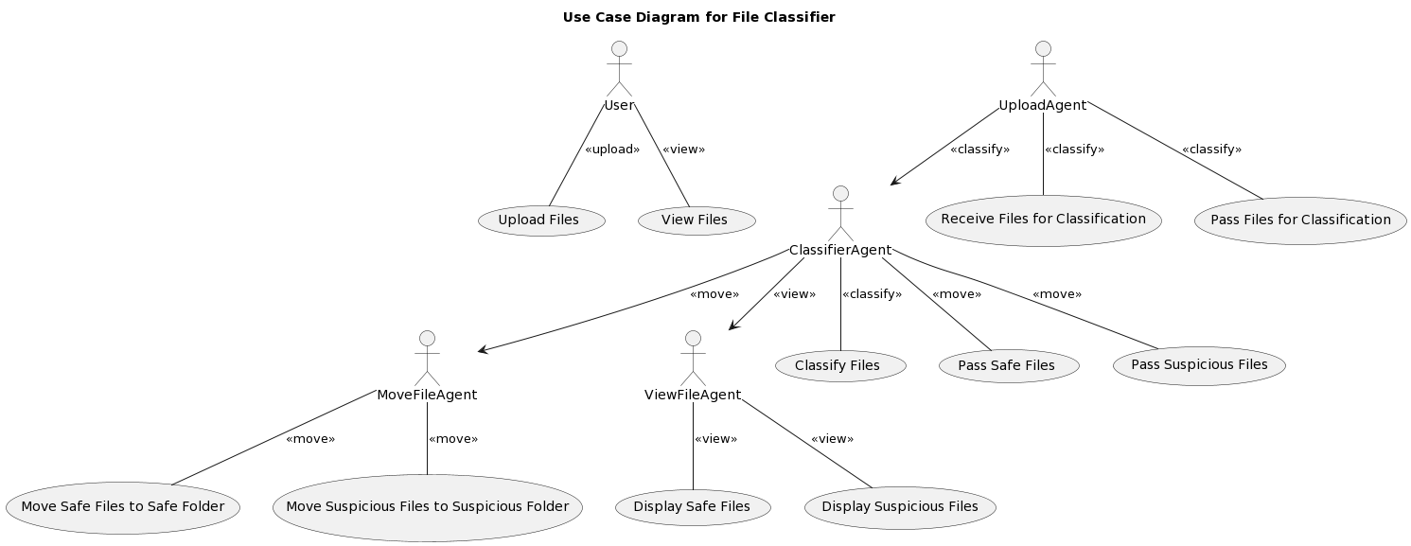
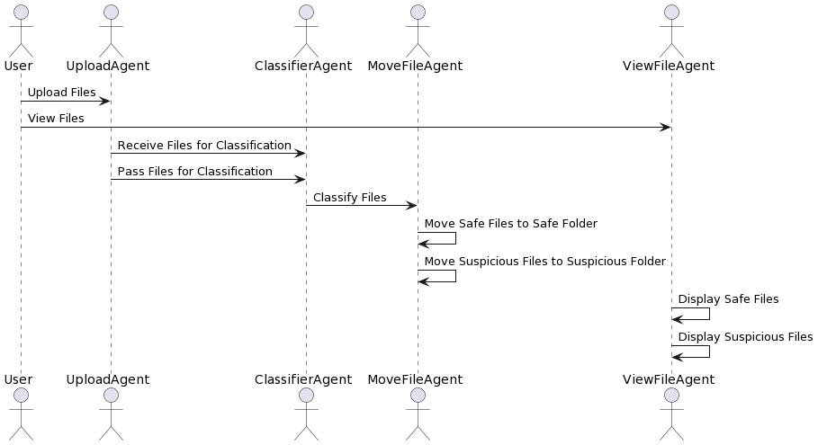
Project Design
Use Case UML
Use case diagrams serve to illustrate the broad functionalities and scope of a system.
Sequence UML
Sequence diagrams employed to highlight specific interaction patterns within the context of the use case.
Notes:
The project's design is visually represented through two UML diagrams. The first diagram is the UML use case diagram, which illustrates the broad functionalities and interactions between the system and its actors. It shows the actors involved, such as the User, UploadAgent, ClassifierAgent, MoveFileAgent, and ViewFileAgent, along with their associated use cases. The relationships between the actors and use cases demonstrate their involvement in actions like file uploading, file viewing, receiving files for classification, passing files for classification, classifying files, moving safe and suspicious files to respective folders, and displaying safe and suspicious files.
The second diagram is the Sequence UML diagram, which highlights the sequential interactions between the actors involved in the use case. It shows the User initiating the process by uploading files, followed by interactions between the User, UploadAgent, ClassifierAgent, MoveFileAgent, and ViewFileAgent. The diagram depicts the flow of actions such as receiving files for classification, passing files for classification, classifying files, moving files to respective folders, and displaying files.
Both diagrams provide an overview of the system's high-level functionalities, interactions, and flow of actions, offering insights into the project's design and functionality.

Slide 6
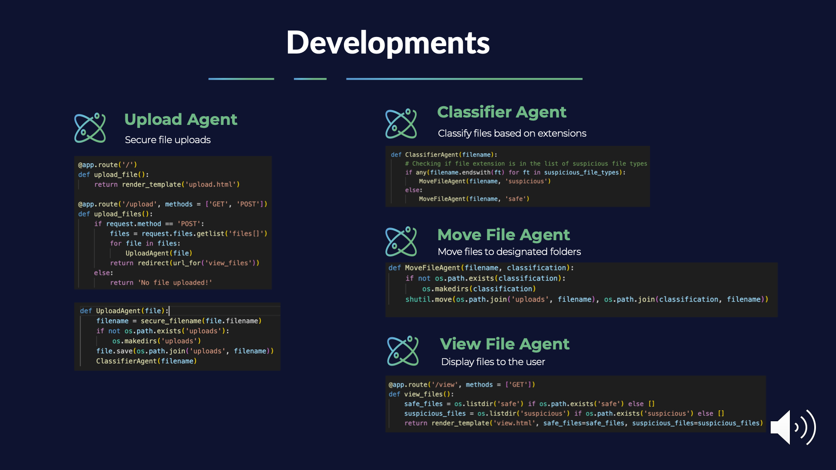
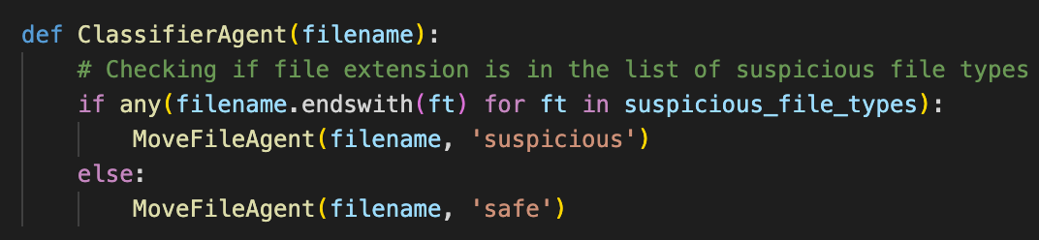
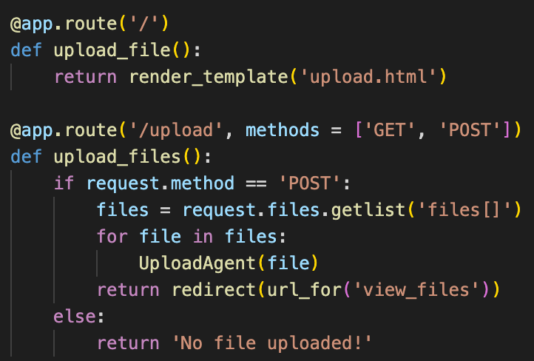
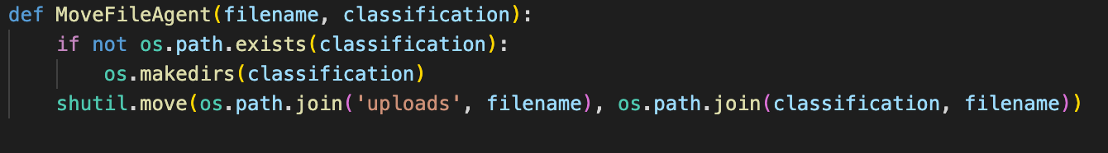
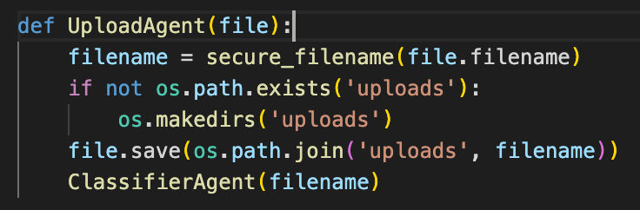
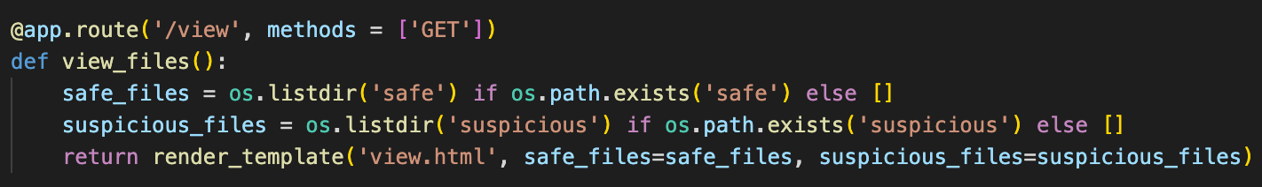

Developments
Upload Agent
Classifier Agent
Secure file uploads
Classify files based on extensions
Move File Agent
Move files to designated folders
View File Agent
Display files to the user
Notes:
In this slide, we will focus on the Development stage of our app. Looking at the code on this slide, we start with the UploadAgent, which is like a secure mailbox. This piece of code allows users to upload files through a simple interface. Once a file is received, it's saved in a separate 'uploads' directory. Then, the ClassifierAgent steps in.
The ClassifierAgent is our detective, examining the uploaded files. It inspects file extensions to identify any that might be suspicious. If the file extension matches our list of suspicious file types, the file is marked as suspicious. Otherwise, it's considered safe.
Once files are classified, MoveFileAgent gets to work. It's the librarian in our system. This code moves files to either the 'Safe' or 'Suspicious' folders based on their classification. This way, our file library stays well-organized.
Finally, we have the ViewFileAgent. This is our display window. It shows you what's inside the 'Safe' and 'Suspicious' folders. With this code, you can see the list of all your files and their classifications.
In summary, each piece of code you see here represents an agent in our system. They work together to ensure files are uploaded, classified, organized, and viewable, providing a secure and user-friendly experience.

Slide 7
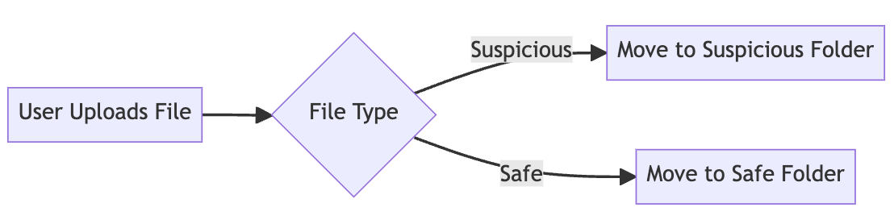
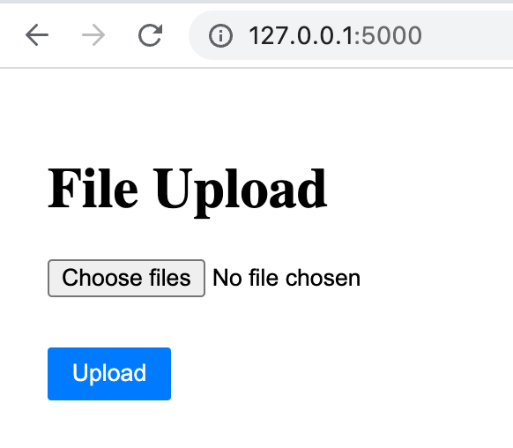
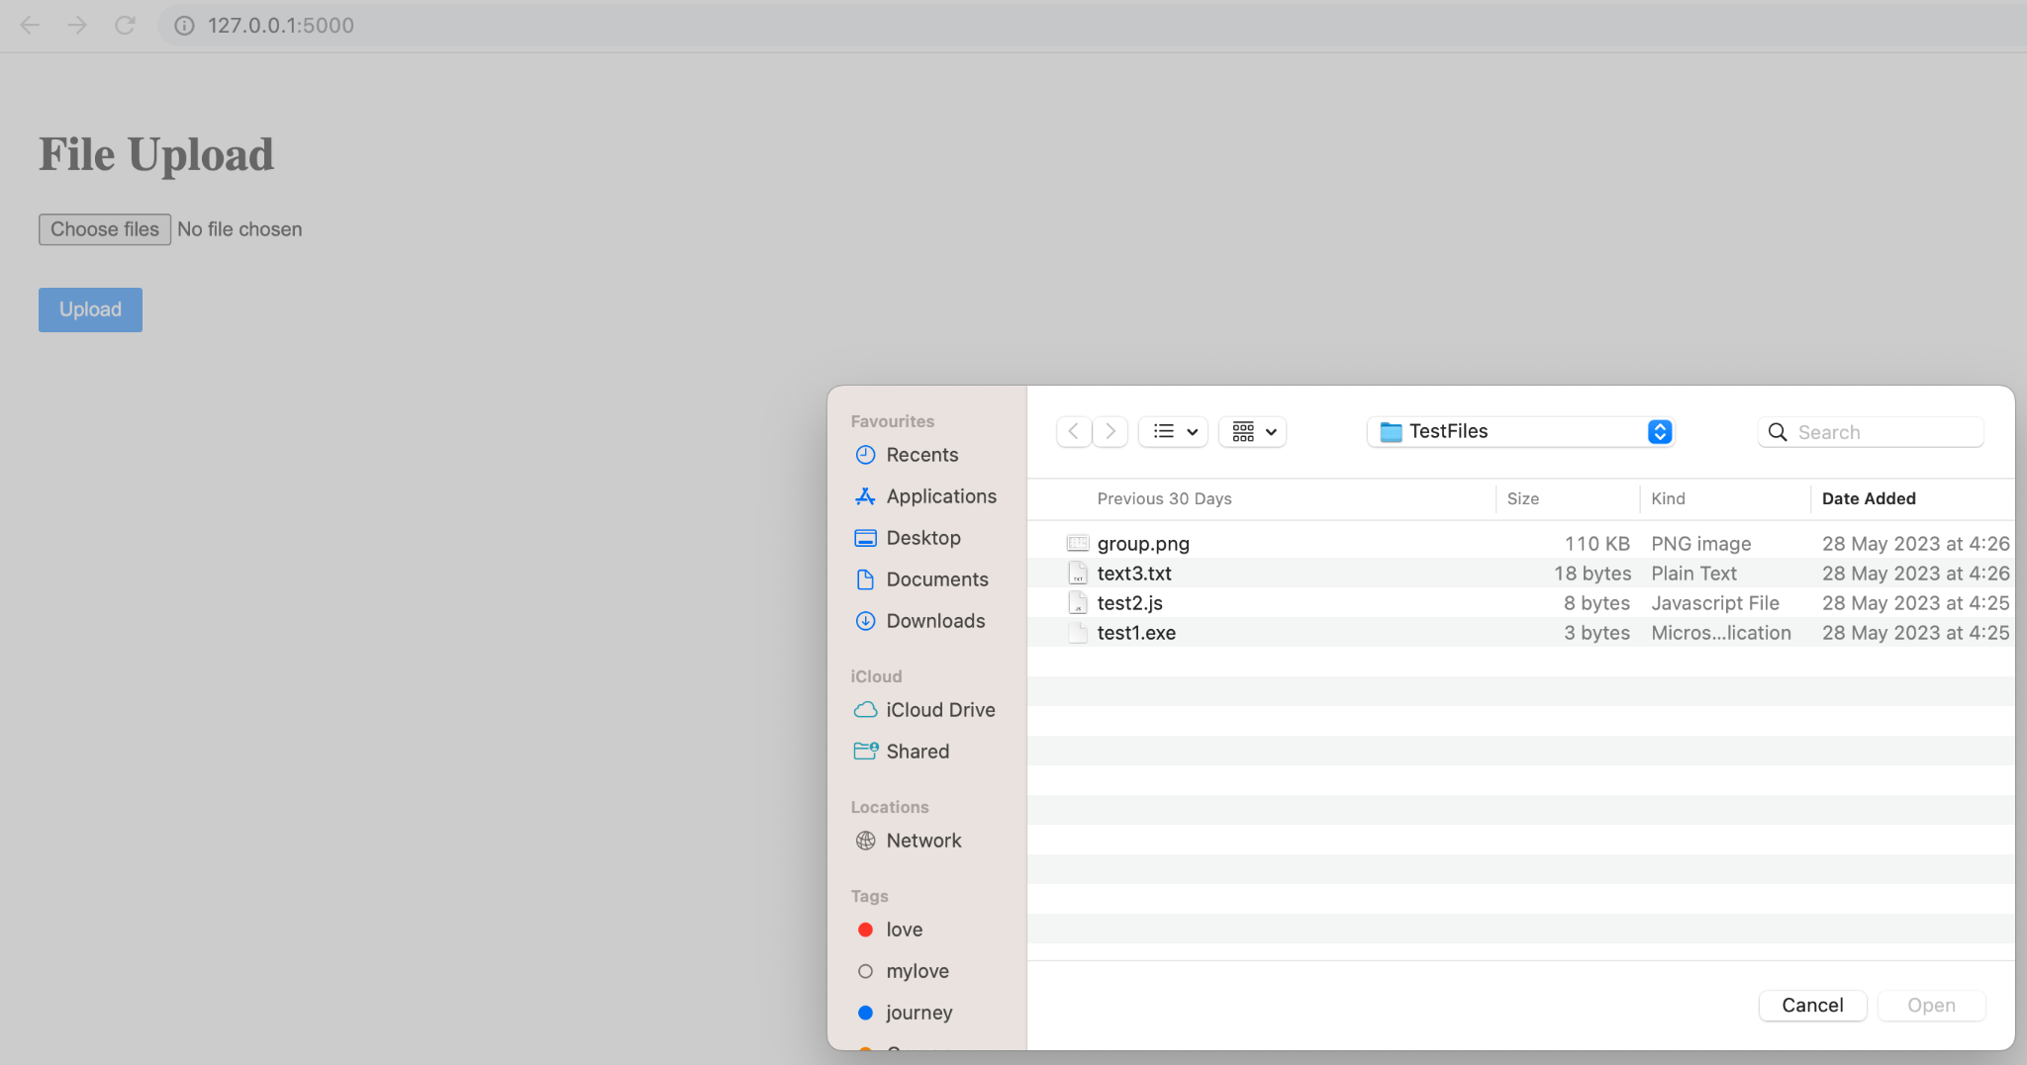
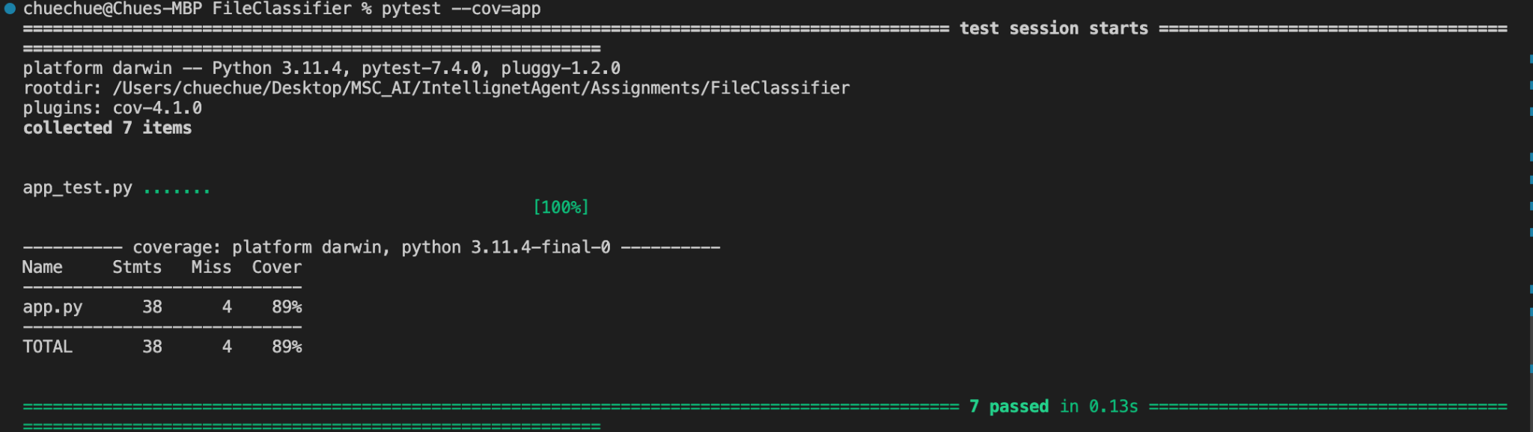
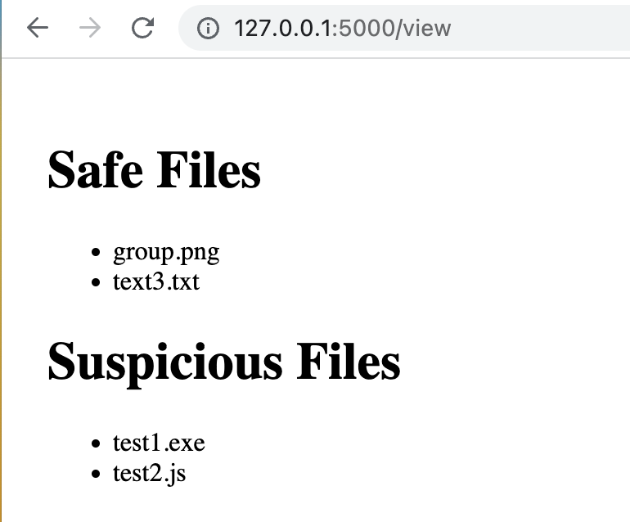
Testing and Evaluation
Objective: Ensuring functionality, identifying issues, evaluating performance, user satisfaction.
Test Types:
Unit: Checks functions.
Integration: Reveals interaction faults.
System: Confirms compatibility.
Performance: Analyzes behavior under load.
UAT: User satisfaction confirmation.
Tools:
Python's unittest for test cases.
pytest-cov and coverage to measure test coverage
Figure 7.2 System Process
Figure 7.3 File Upload UI
Figure 7.4 File Browser UI
Figure 7.1 Unit Test Result
Figure 7.5 Result of Classified Files UI
Notes:
This slide focuses on the Testing and Evaluation stages of our File Classifier application. The objective here is to ensure the application's functionality, identify potential issues, evaluate performance, and validate user satisfaction.
We have employed a variety of testing types to achieve these objectives. Starting with Unit Testing, we rigorously checked individual functions for expected outcomes using Python's unit test library.
Integration Testing followed, revealing any faults that might occur when these units interact with each other.
Then, we moved to System Testing, examining the application as a whole, and confirming that all parts coalesce into a compatible, smoothly functioning system.
Performance testing was also crucial, analyzing the behaviour of the application under heavy load. This assessment ensures our application remains robust and reliable even when processing a large number of files.
Finally, we conducted User Acceptance Testing, or UAT, which played a key role in confirming user satisfaction and validating that the application effectively meets user needs.
For conducting these tests and measuring their coverage, we utilized Python's unit test, pytest-cov, and coverage libraries.
The screenshot labeled Figure 7.1, showcases the results of our unit tests. With a coverage of 89%, a majority of our code is tested and verified to function as expected.
Now, let's talk about Figure 7.2, our system process flow diagram. It starts with the Upload File stage. From there, the system determines the file type. If a file is deemed suspicious, it is moved to a suspicious folder. Safe files, on the other hand, are relocated to a safe folder. This flow diagram encapsulates the logic behind our application.
Turning to our User Interfaces, let's look at Figure 7.3 - the File Upload UI. This is the entry point for users, where they can upload multiple files for classification.
Next, we have Figure 7.4, the File Browser UI. Here, users can navigate through their file system, allowing for easy selection of files.
Finally, Figure 7.5 showcases the Result UI, where files are listed as either safe or suspicious, providing users with a clear understanding of the file classification results.
Through these robust testing methods, we have ensured functionality, performance, and user satisfaction with our application.

Slide 8
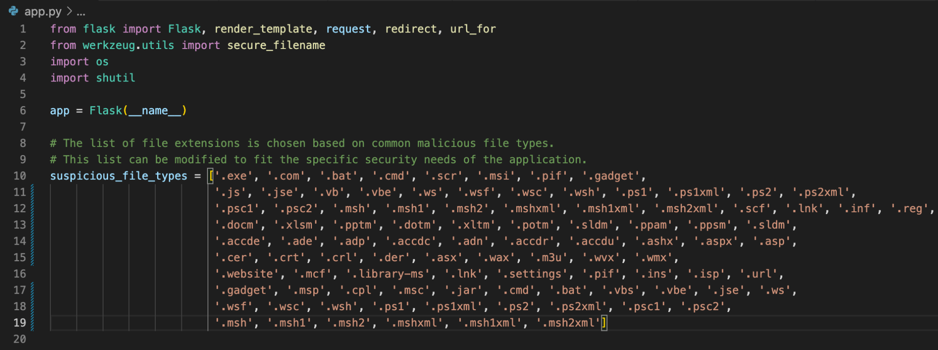
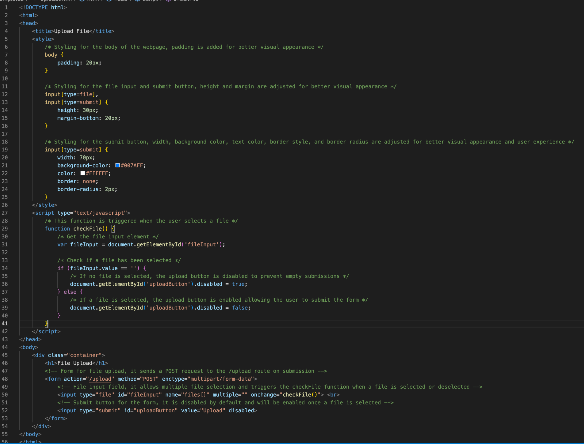
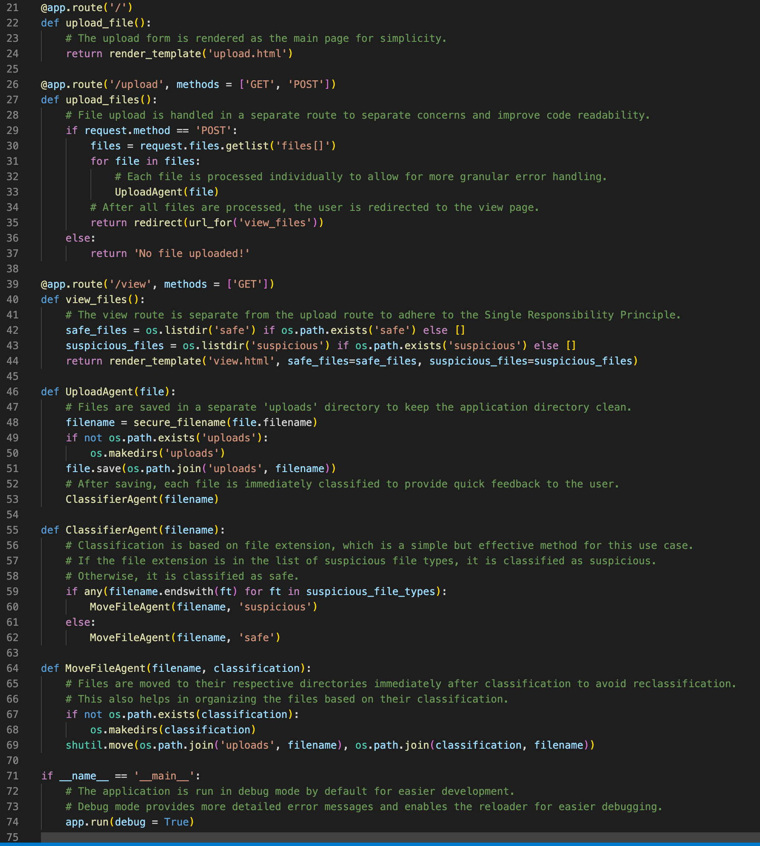
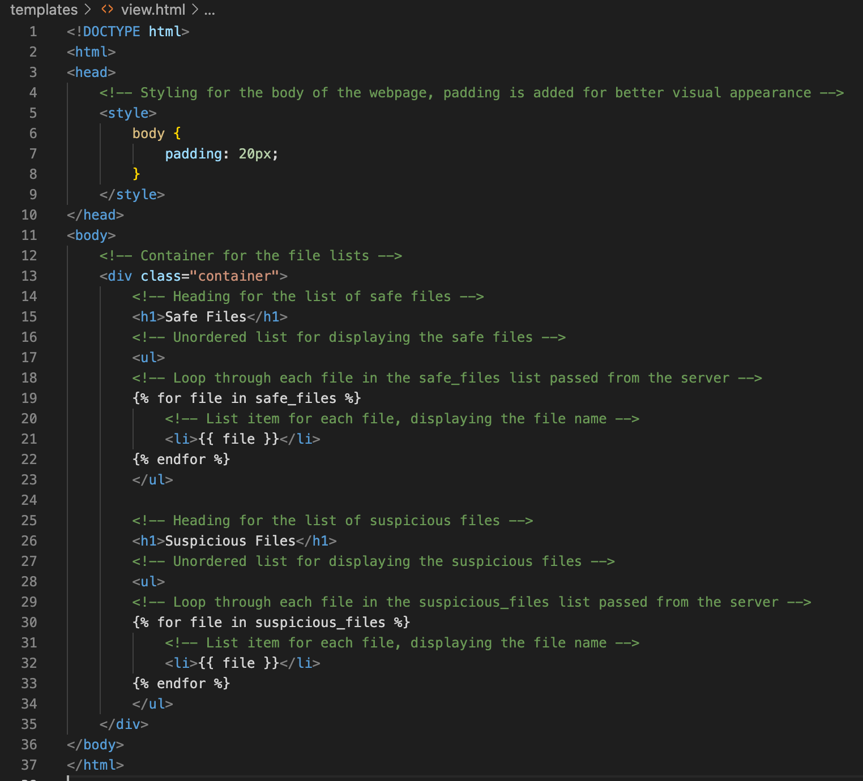
Programming Approach
app.py
Programming approach: Python programming
Flask: Lightweight framework for building web interfaces
Werkzeug: Ensures security in file handling and communication
os: Handles operating system-dependent functionalities
shutil: Performs high-level file operations and management
upload.html
HTML template for the file upload page.
Allows users to select and upload files.
Includes JavaScript code for handling file selection and enabling/disabling the upload button.
view.html
HTML template for the file viewing page.
Displays the list of files categorized as "safe" and "suspicious".
Utilizes Flask template syntax to dynamically populate the file list.
upload.html
app.py
view.html
Notes:
This slide provides a glimpse into our Programming Approach while developing the File Classifier application.
Let's begin by looking at our main server file, app.py, shown in the snippet on this slide. We've chosen Python as our programming language due to its readability, simplicity, and vast library support.
In this file, we make use of the Flask framework, which is lightweight and perfect for our web interface needs. We've also employed Werkzeug, a comprehensive WSGI web application library. It offers various utilities to ensure secure and efficient file handling and communication between our server and the clients.
We also utilized built-in Python modules such as os and shutil. The 'os' module handles operating system-dependent functionalities, such as path manipulation, whereas 'shutil' is responsible for high-level file operations like moving our files to the 'safe' or 'suspicious' folders.
Moving on to our front-end, we have the upload.html file. This HTML template forms the File Upload Page, a user-friendly interface where users can select and upload their files. It also includes a small JavaScript snippet to enhance user experience by enabling or disabling the 'Upload' button based on whether files are selected.
Finally, let's look at the view.html file. This HTML template acts as the File Viewing Page, where users can see the results of our file classifier. It lists files categorized as "safe" or "suspicious", providing a transparent overview of the classification results. We've utilized Flask's template syntax here to dynamically populate the file list based on the results from our server.
Together, these components form the basis of our programming approach, balancing user-friendly front-end interfaces with a secure, efficient back-end server.

Slide 9
Challenges
and Solution
Accuracy
Accurate file classification
Guaranteeing accurate file classification and securing file uploads are paramount challenges in our development process
Security
Secure file upload to prevent attacks
Validation
Testing and validation
Notes:
One of the key challenges we anticipate in the development process revolves around ensuring the precise classification of files. The conventional method of relying solely on file extensions can be misleading, particularly if a malicious file is disguised with a benign extension (Casey, 2011). Therefore, it becomes crucial for us to implement a robust mechanism that goes beyond file extensions to accurately identify and classify files.
Another critical concern is ensuring secure file uploads to mitigate the risk of directory traversal attacks. This type of attack occurs when an attacker manipulates file paths to access unauthorized directories and potentially compromise the system's security. To address this concern, we need to implement effective input validation techniques and conduct regular security testing (Stuttard & Pinto, 2011). By doing so, we can minimize the vulnerability to directory traversal attacks and safeguard the integrity and security of our file classification system.
In summary, guaranteeing accurate file classification and securing file uploads are paramount challenges in our development process. We need to overcome the limitations of file extensions by adopting a more comprehensive approach to classification. Additionally, implementing robust input validation and conducting regular security testing will fortify our system against directory traversal attacks and bolster its overall security posture.

Slide 10


Developed multi-agent system for file classification and segregation - Created user interface - Testing and validation
Limitations – filename extension basis only
Further study – classification based on content and user defined attributes – use machine learning and natural language processing to enhance performance
Thanks
Notes:
In conclusion, we successfully developed multiple agents to classify files based on their file name extension. User-friendly interface was created to review the classification results The performance of the agents were successfully tested and validated.
The potential drawbacks of using only filename extension as a basis for file classification were discussed. In future, this project could be further extended to classify files based on their content or other user defined attributes and could use machine learning methods and natural language processing to enhance agent performance.
Overall, our project with a multiagent system for file classification couples the power of multiple autonomous agents to achieve efficient and accurate file organisation. By utilising such systems can improve file management, retrieval, and decision-making processes in diverse domains

